Slide 1
3. Pivot Tables and Charts
Varsha mhetre

Slide 2
What is use of Pivot Tables?
You can use a PivotTable to summarize, analyze, explore, and present summary data.
PivotCharts complement PivotTables by adding visualizations to the summary data in a PivotTable, and allow you to easily see comparisons, patterns, and trends.
Both PivotTables and PivotCharts enable you to make informed decisions about critical data in your enterprise.

Slide 3
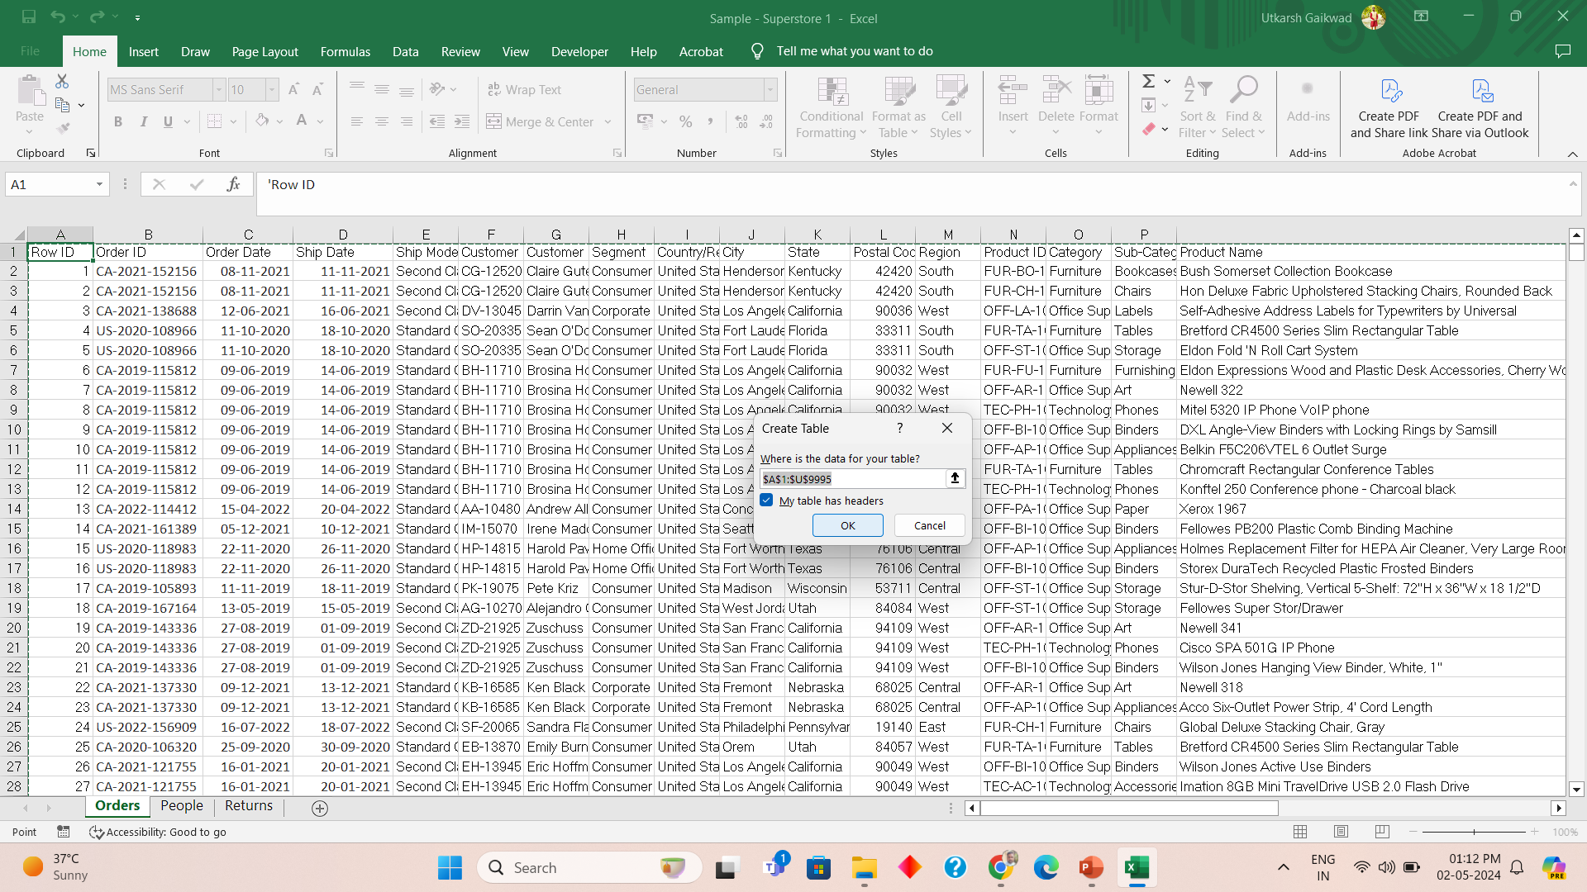
Convert data into table first – Ctrl + T
Press Ctrl + T for
Creating Table
Then click OK

Slide 4
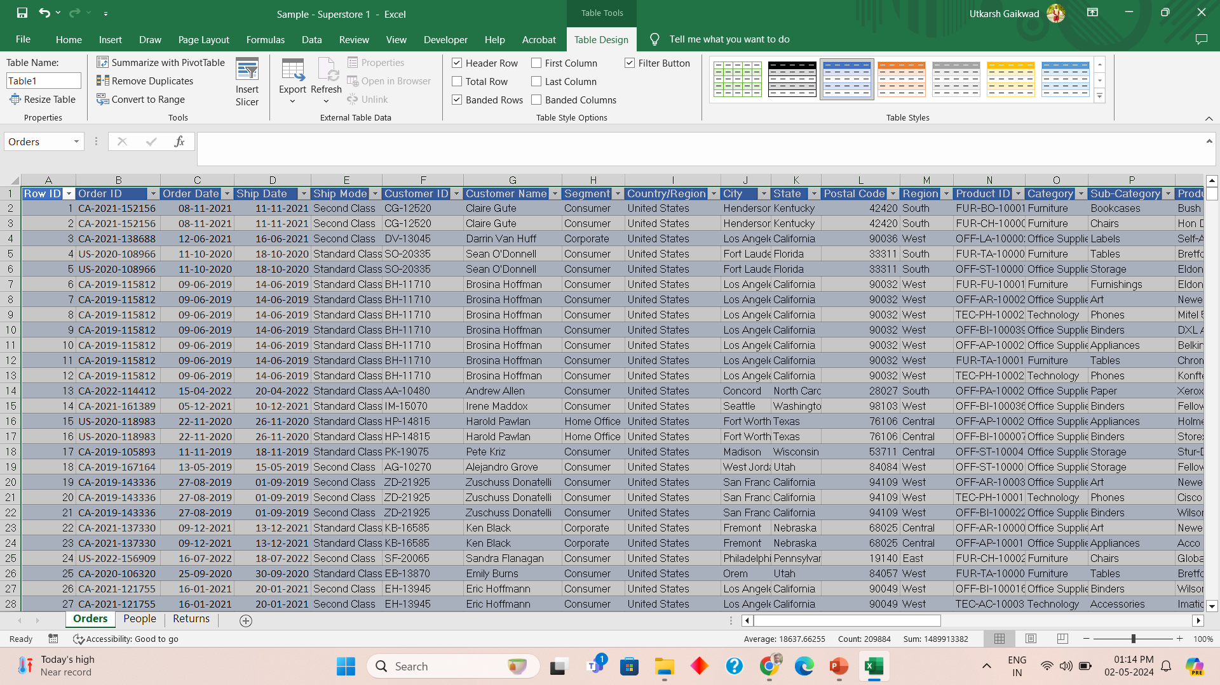
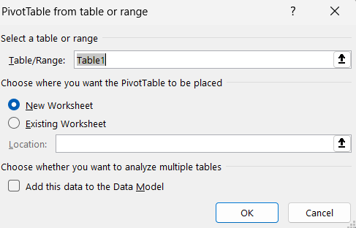
Summarize with Pivot Table

Slide 5
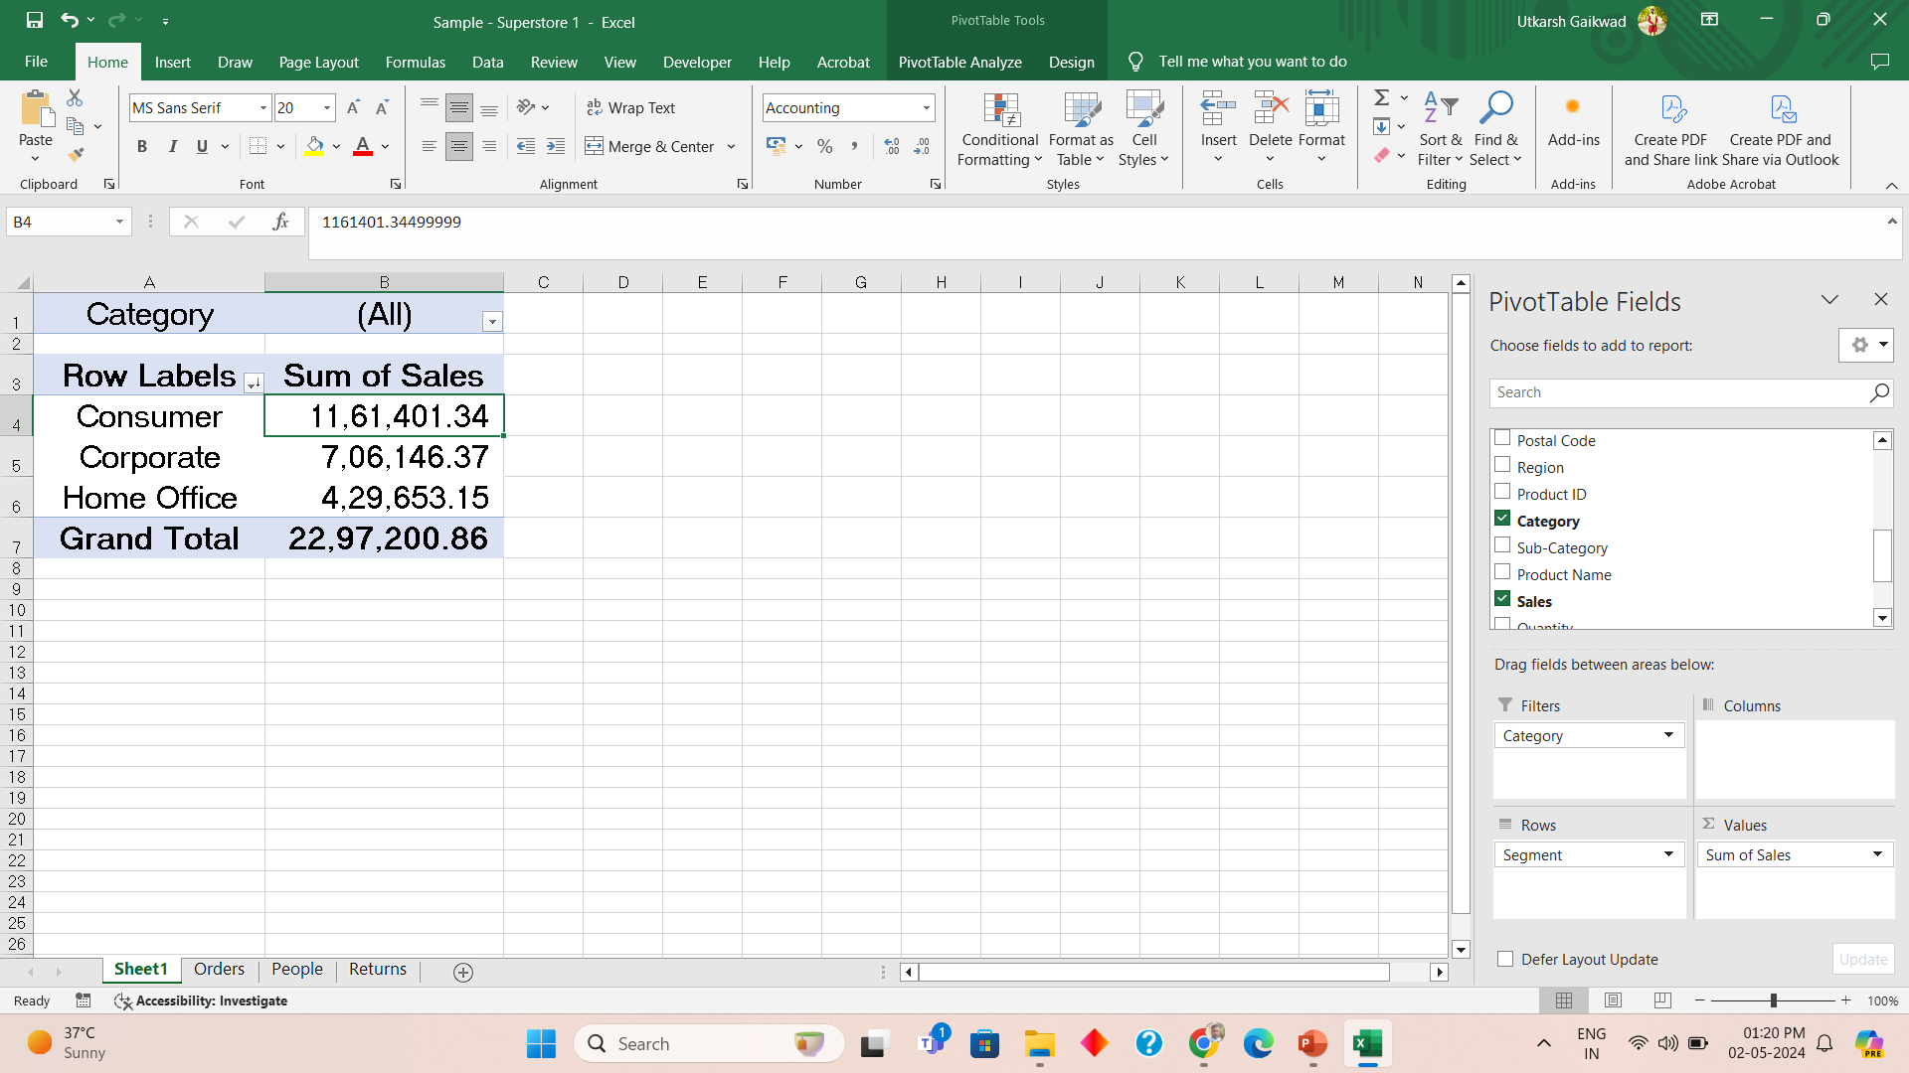
Pivot Table Segment Wise Sale

Slide 6
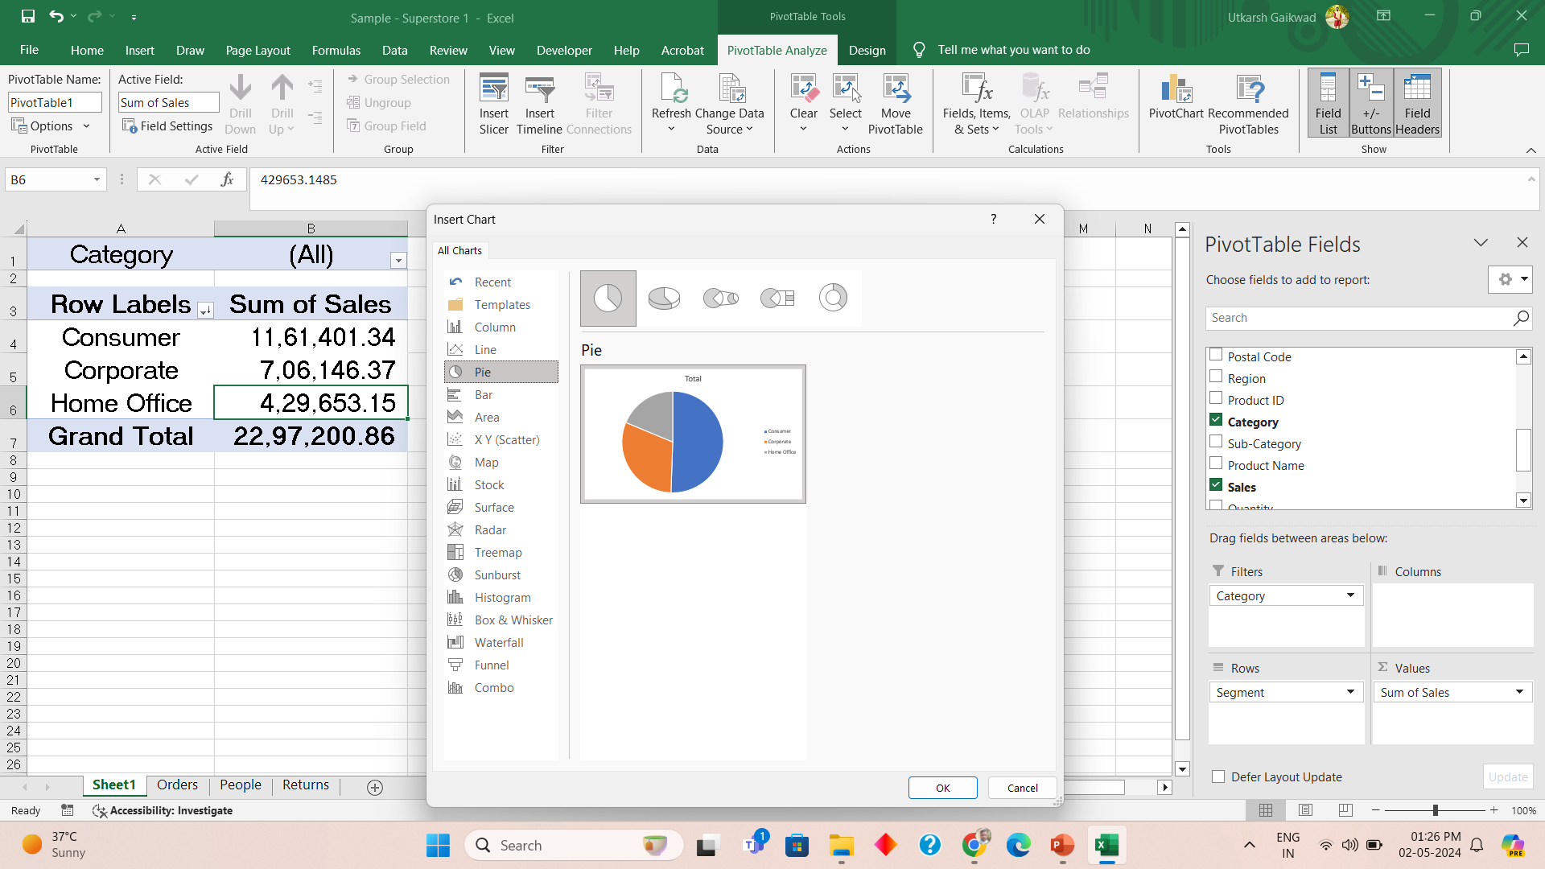
Pivot Chart – Pie Chart
Step 1: Pivot Table
Analyse
Step 3: Pie Chart
Step 2: Pivot Chart
Step 4: Ok

Slide 7
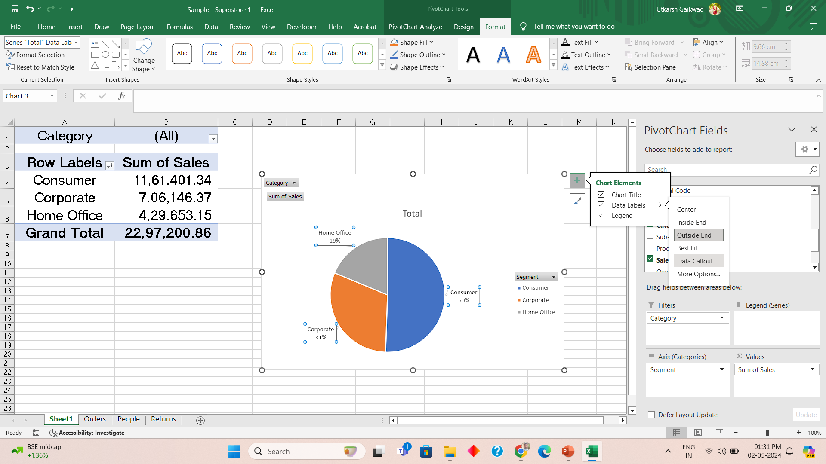
Formatting the Pivot chart

Slide 8
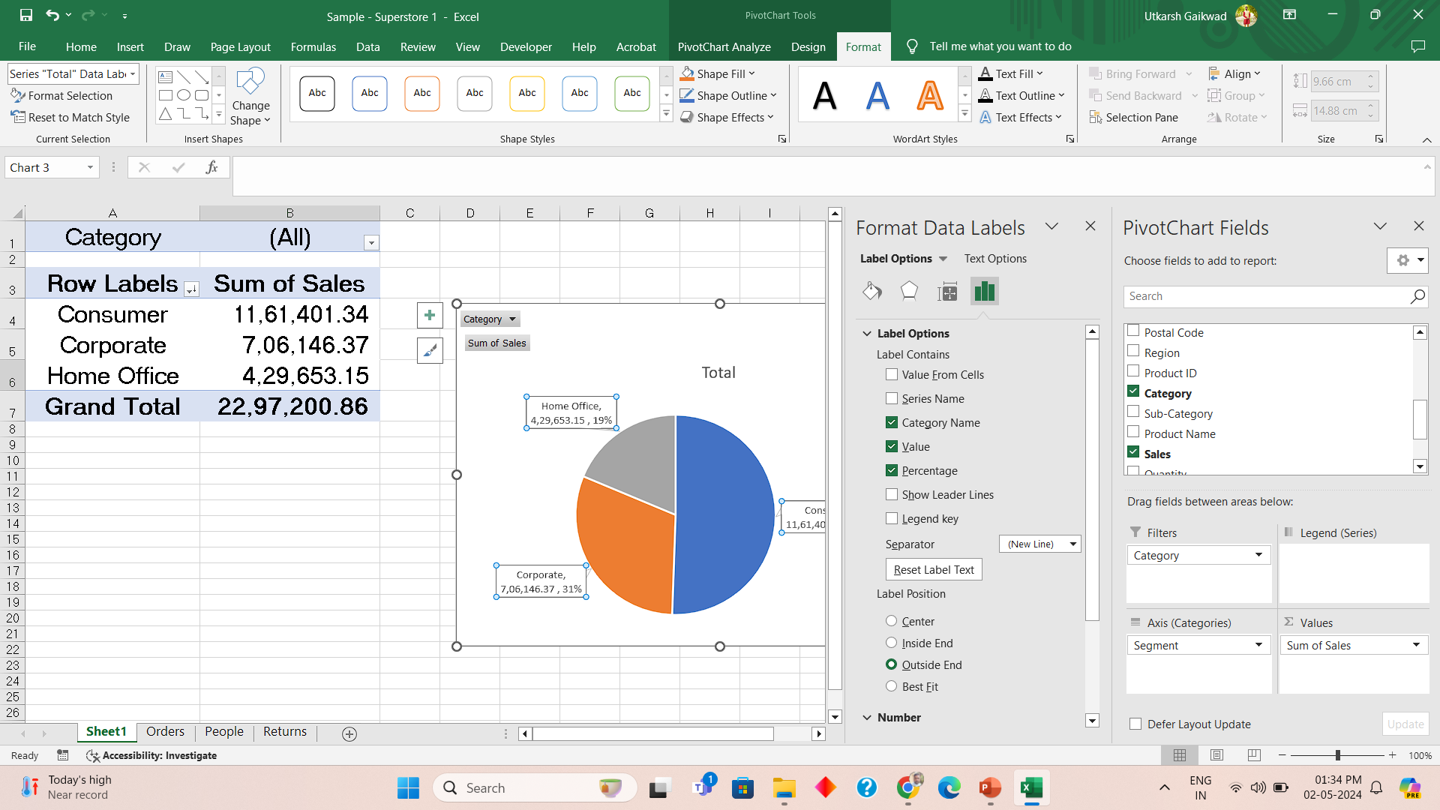
More formatting options

Slide 9
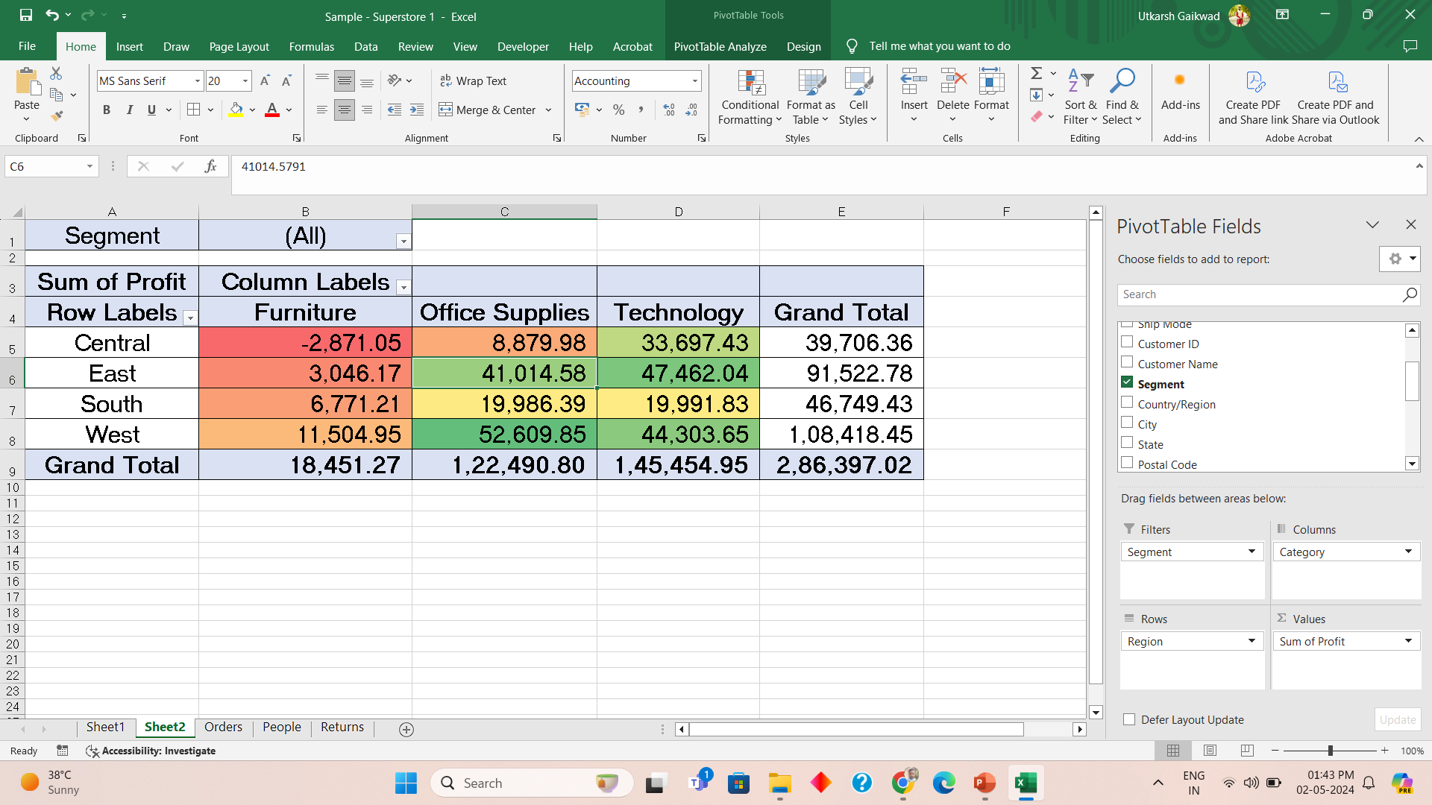
Category and Region Wise Profit

Slide 10
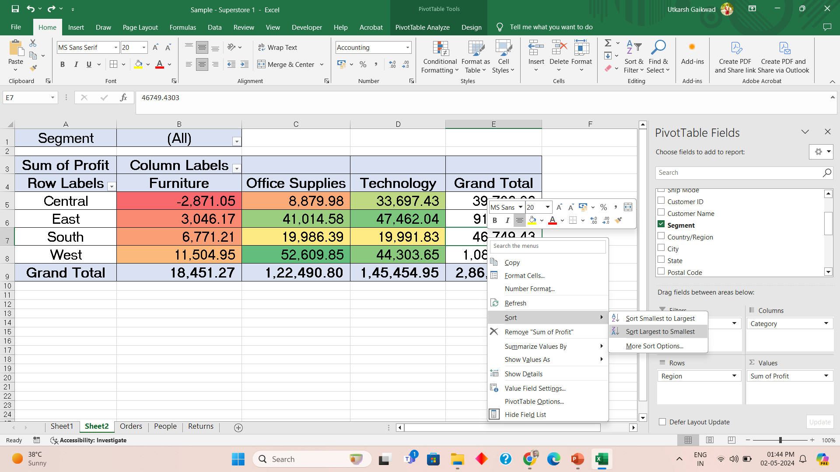
Sort values by rows and columns

Slide 11
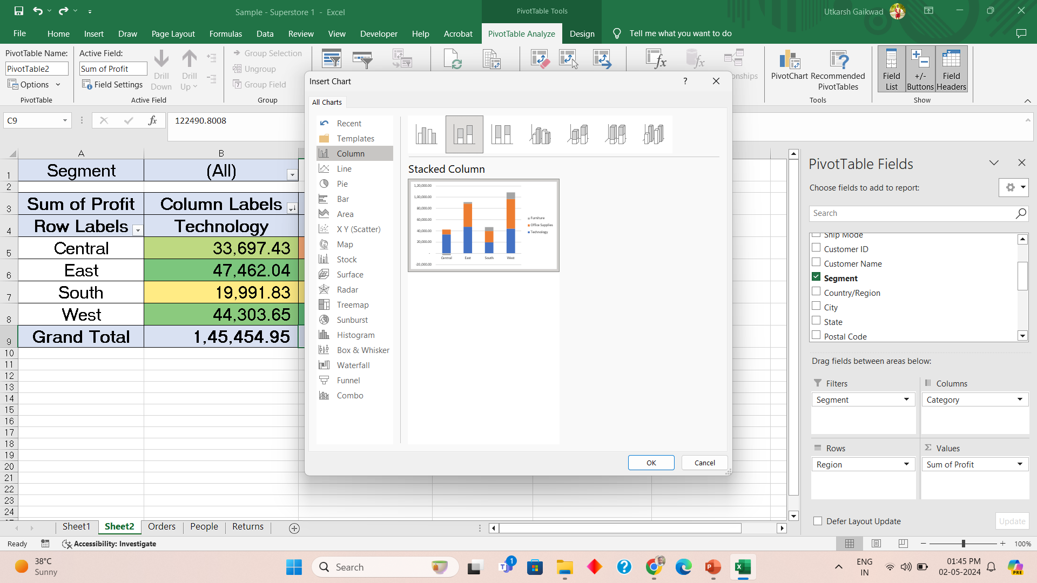
Stacked Column Chart
1
4
2
3
5

Slide 12
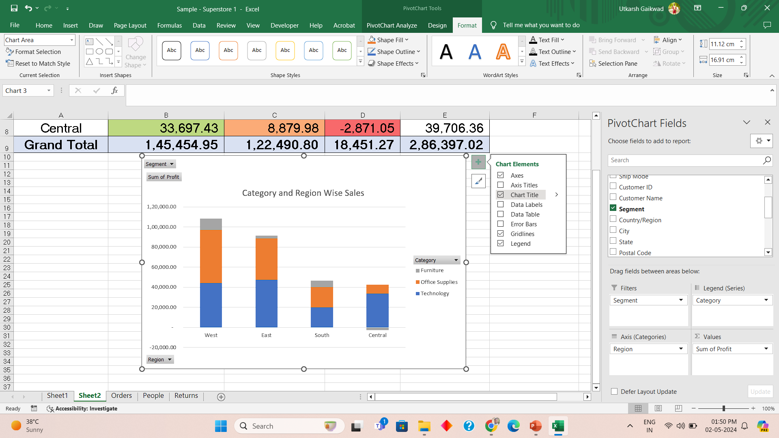
Formatting chart

Slide 13
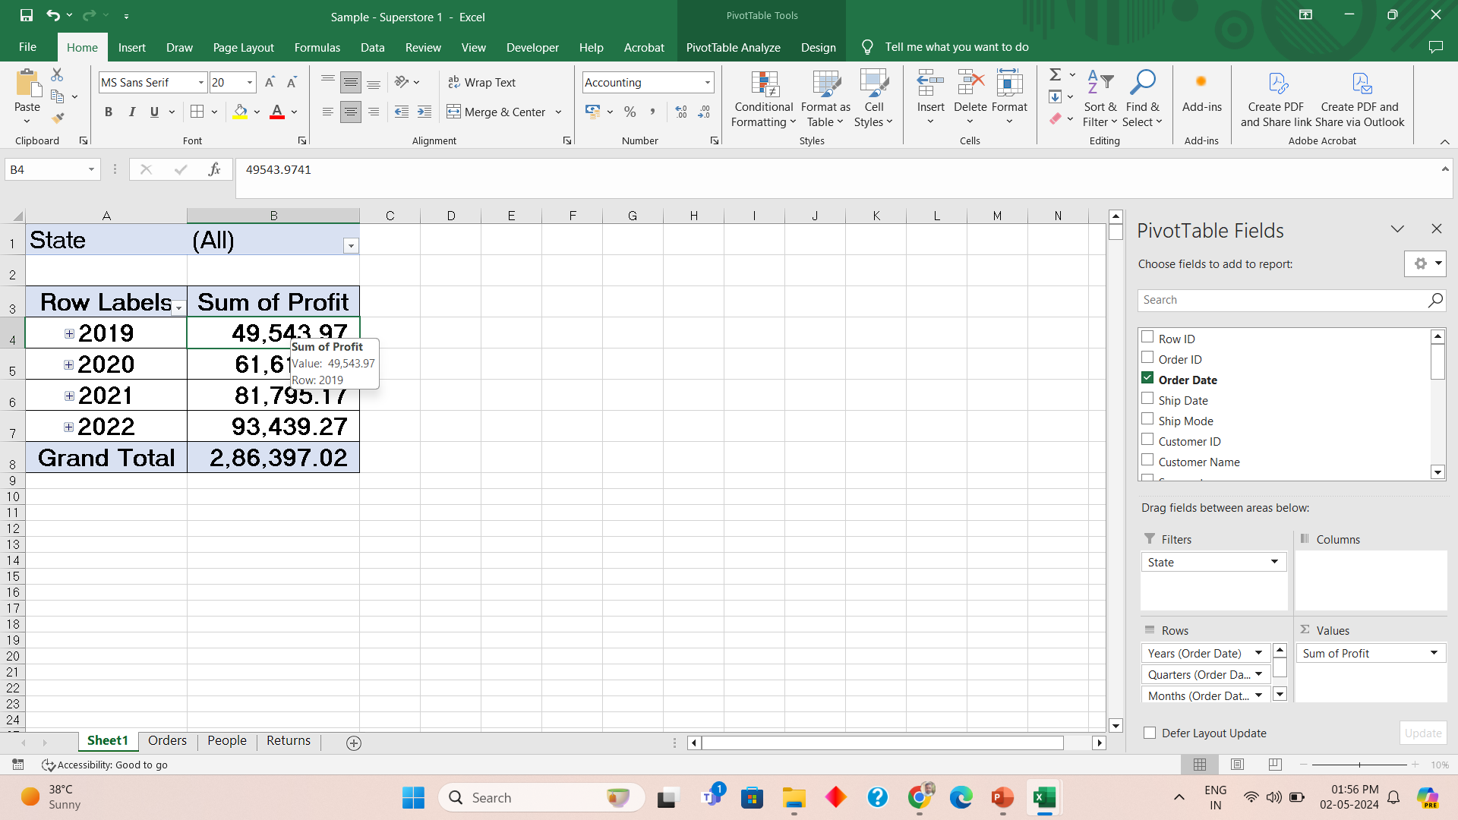
Order Date wise total Profit Monthly

Slide 14
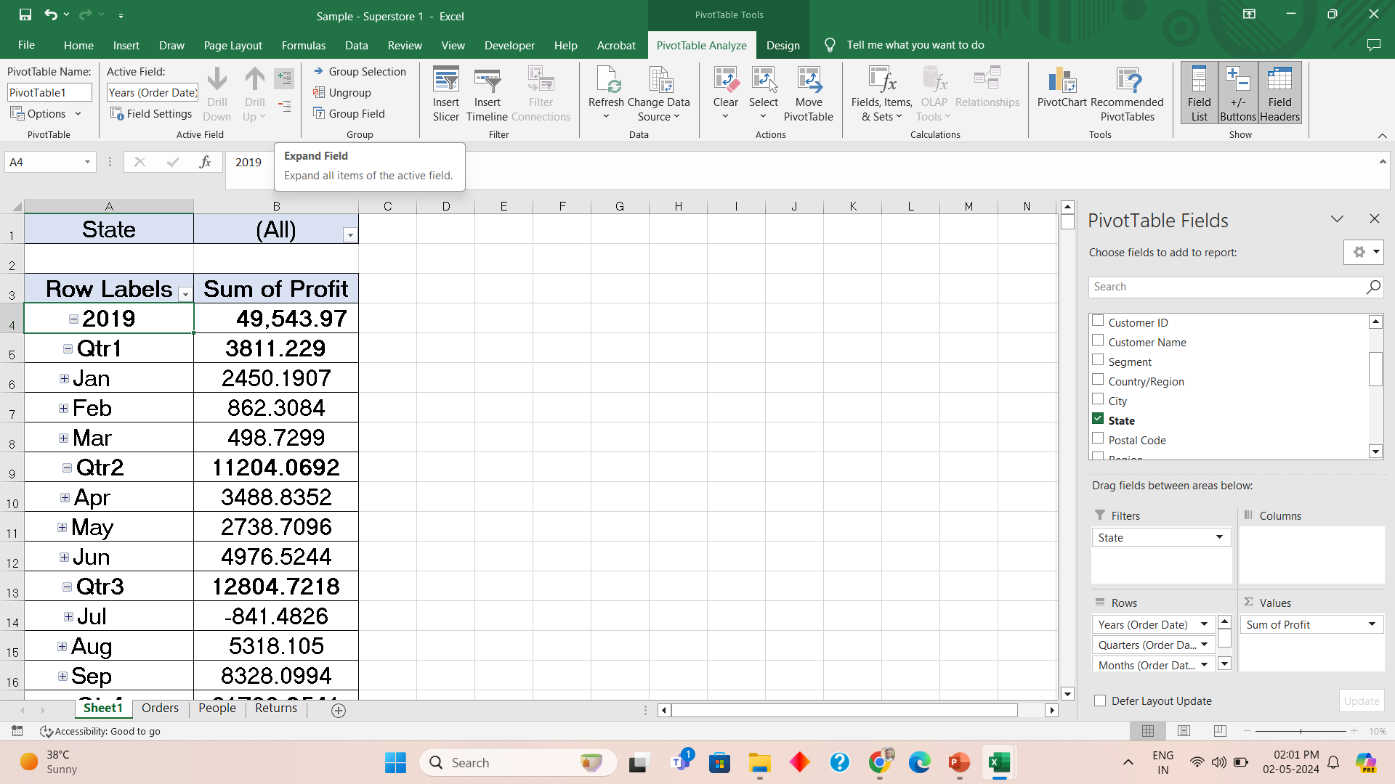
Getting Monthly Data

Slide 15
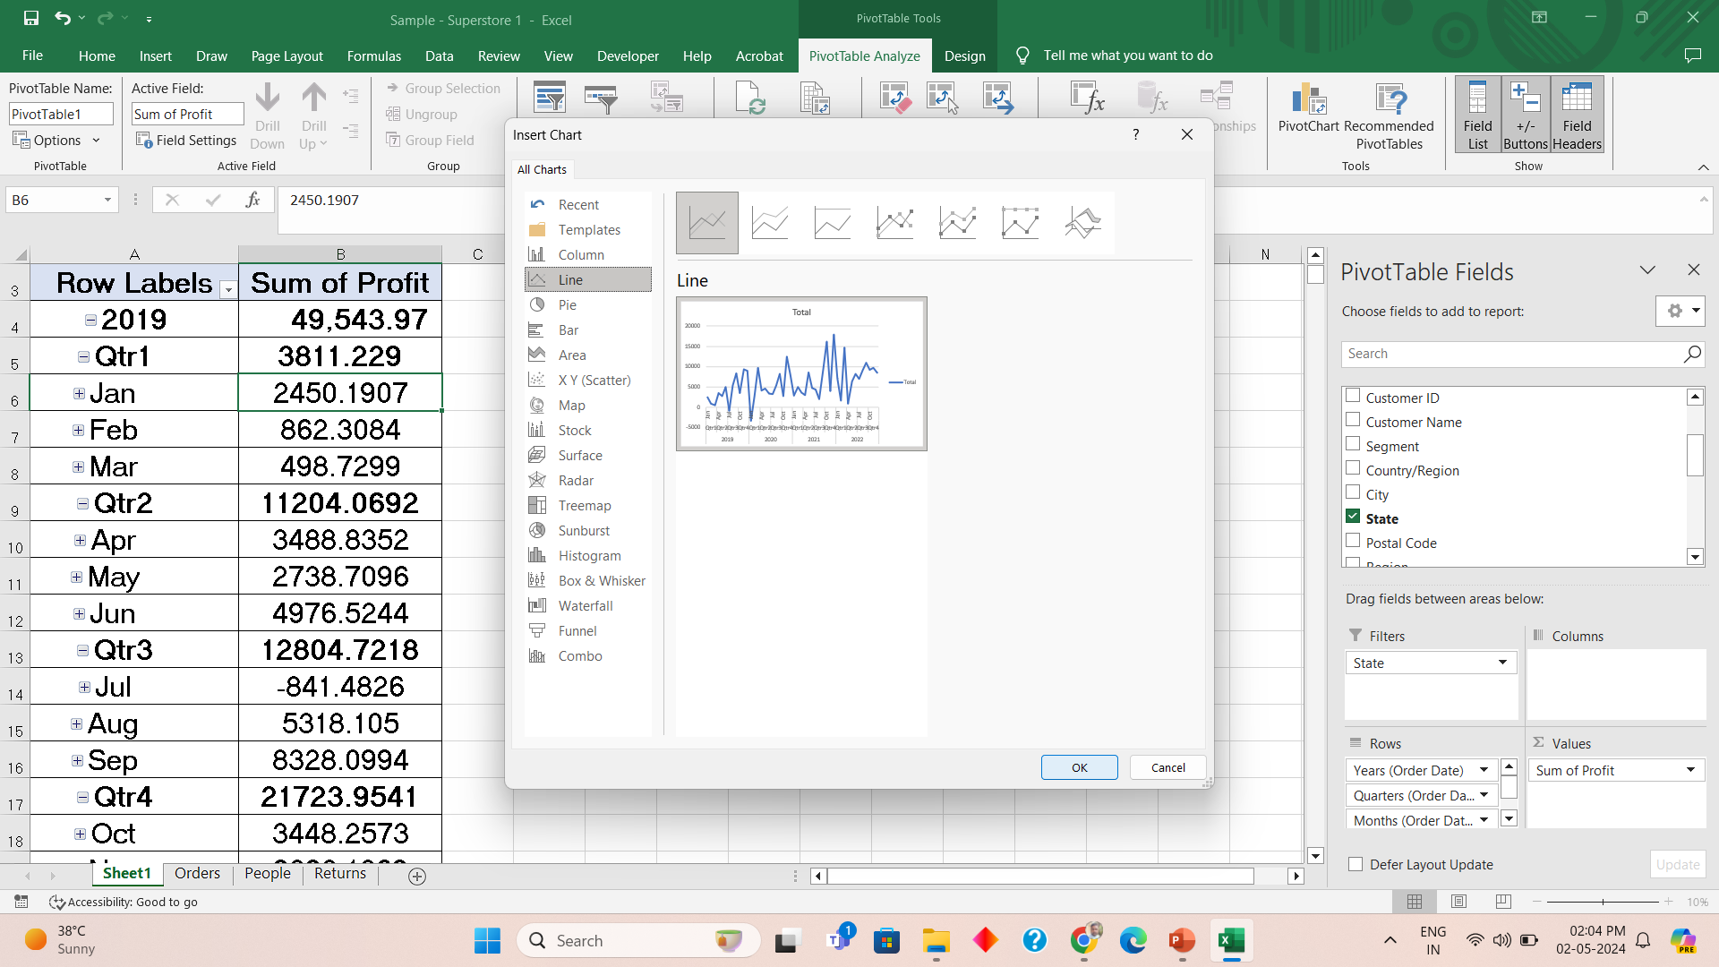
Line Chart

Slide 16
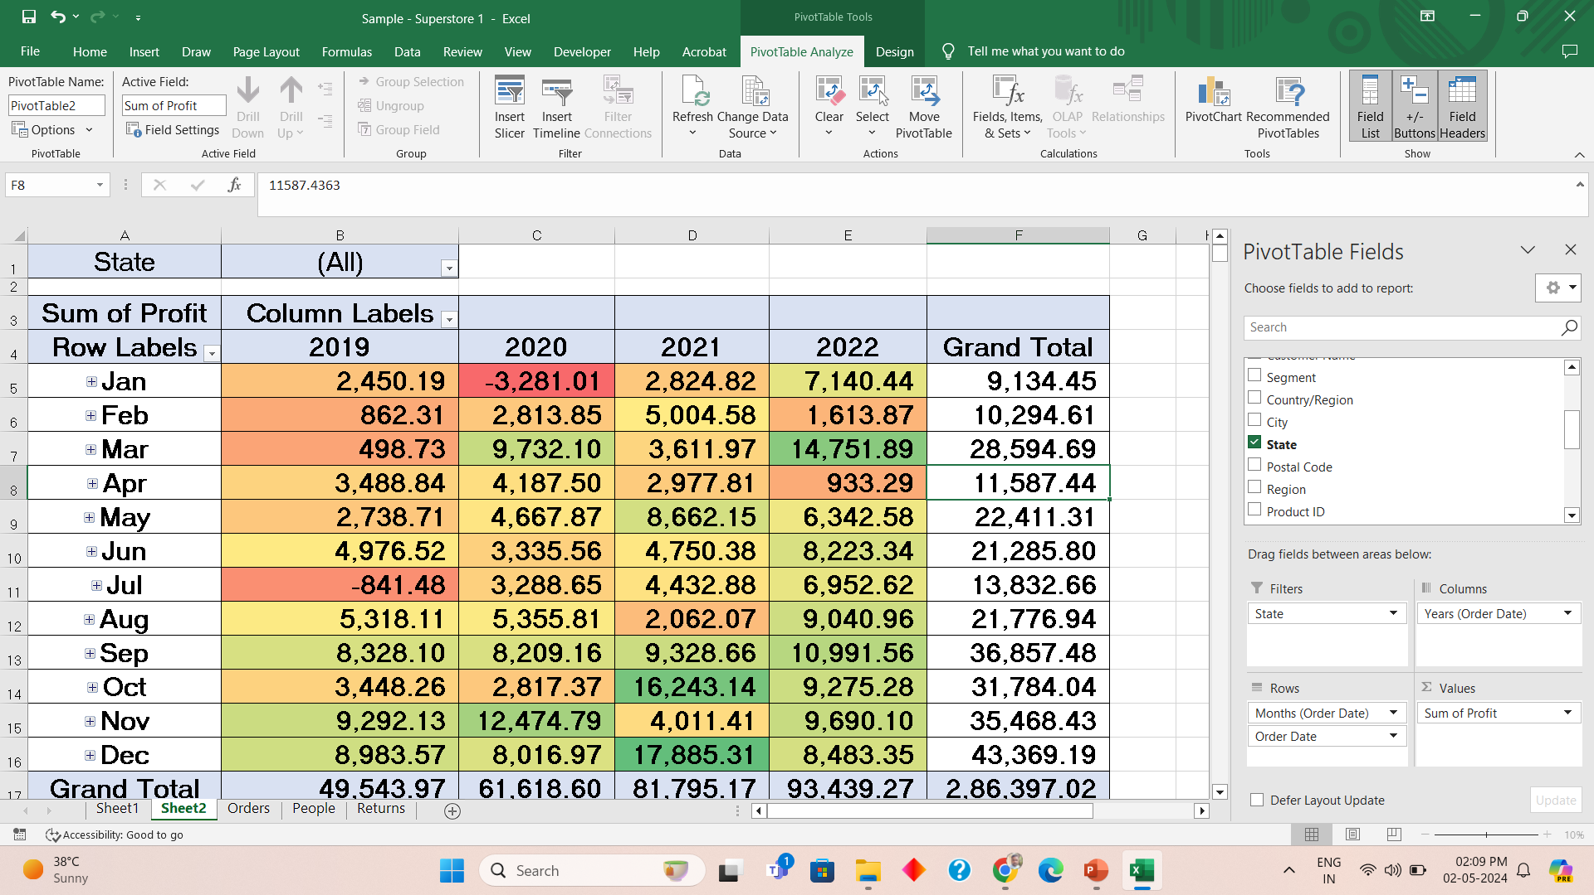
Order date by profit different method

Slide 17
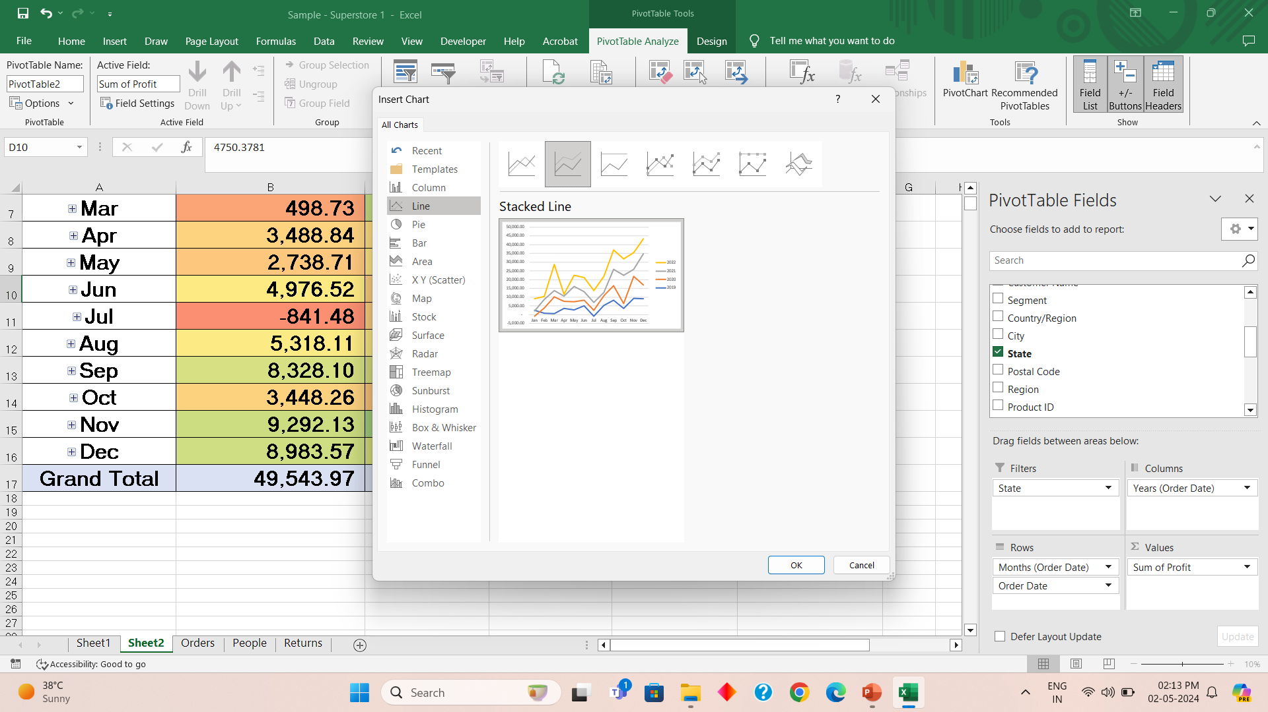
Stacked Line chart

Slide 18
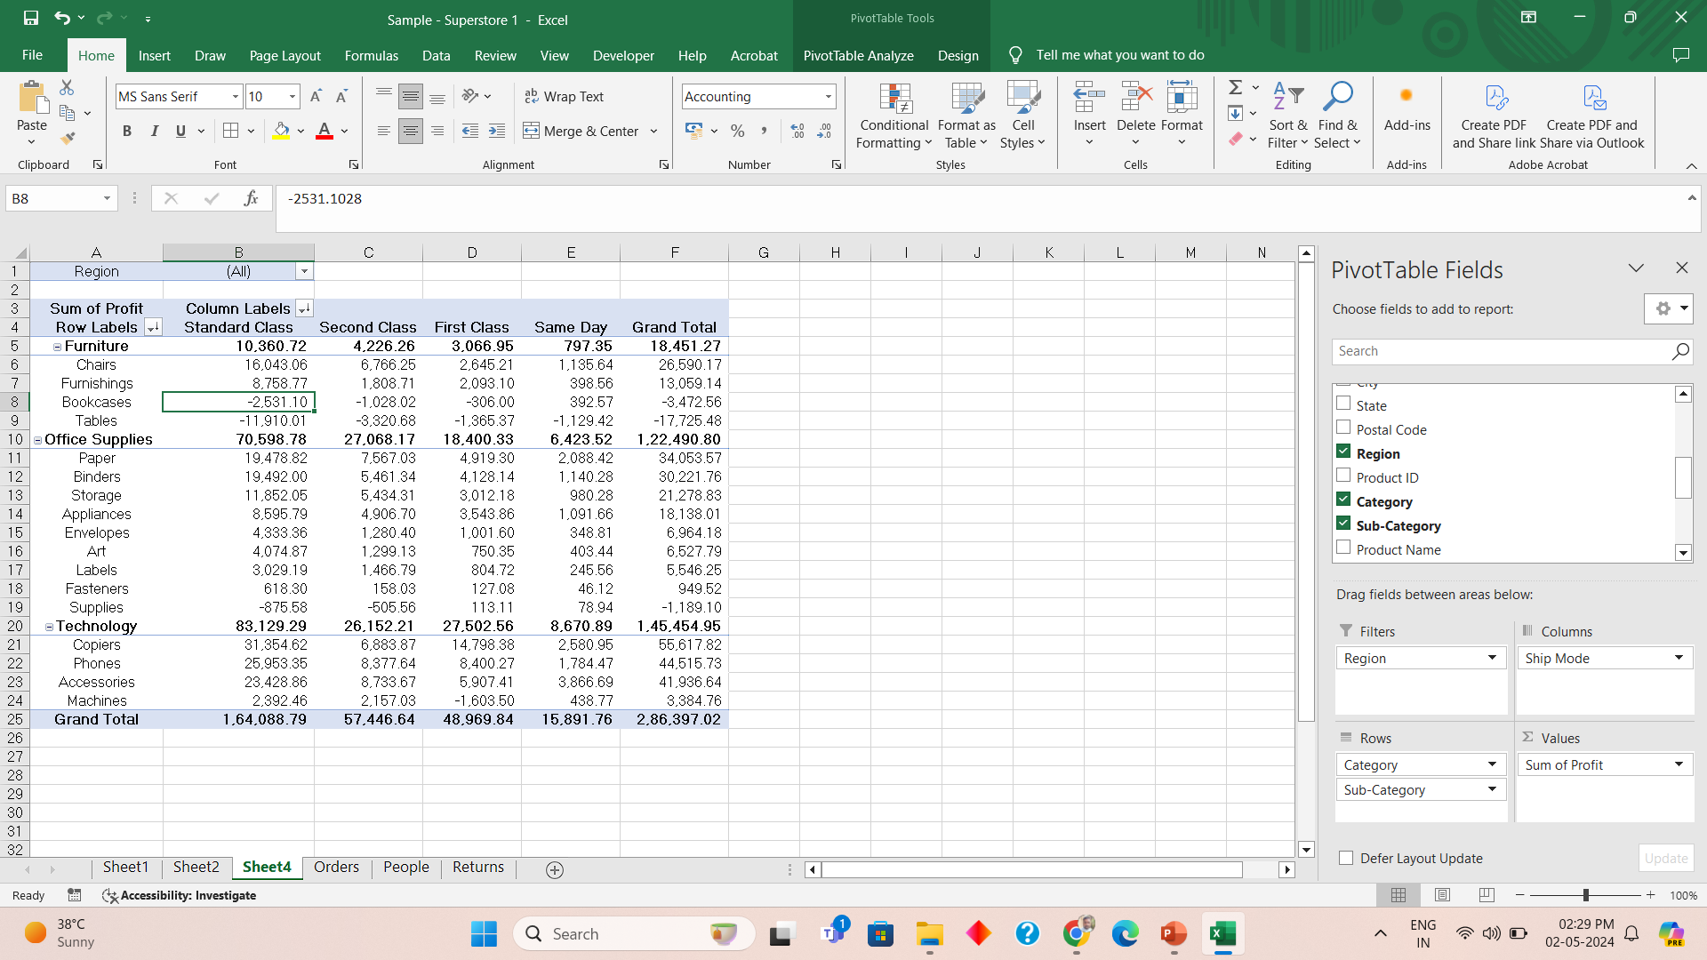
Profit by Subcategory and Ship type

Slide 19
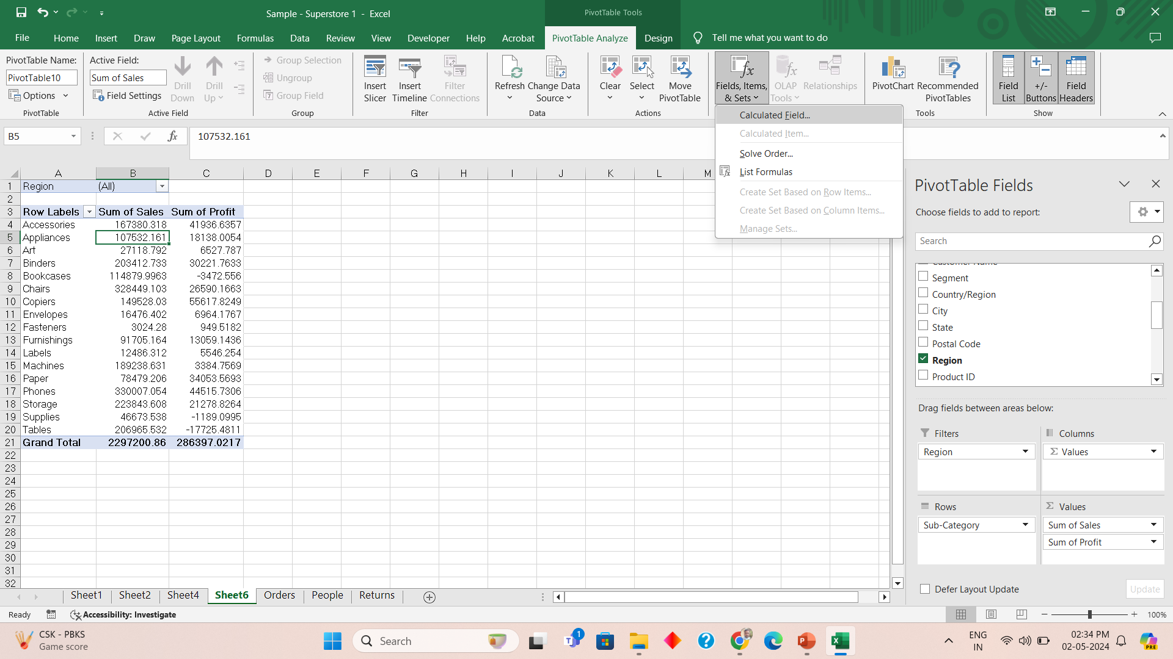
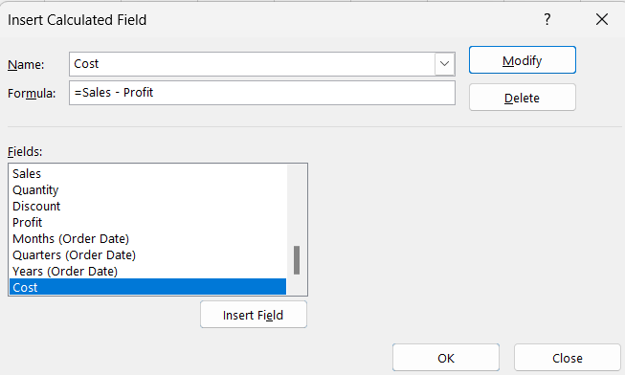
Calculated Field - Cost

Slide 20
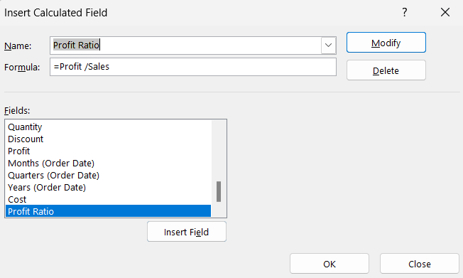
Calculated field profit ratio

Slide 21
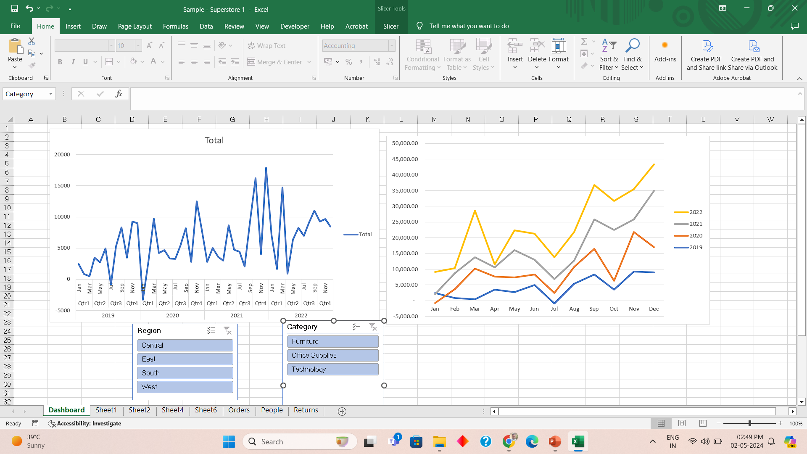
Combine to create dashboard like visuals

Slide 22
Thank You
Varsha mhetre

